Slide 1
Beyond the label
Restorative alternatives to discipline in middle school.
From pathologizing adolescent distress to classrooms built for repair and belonging.

Slide 2
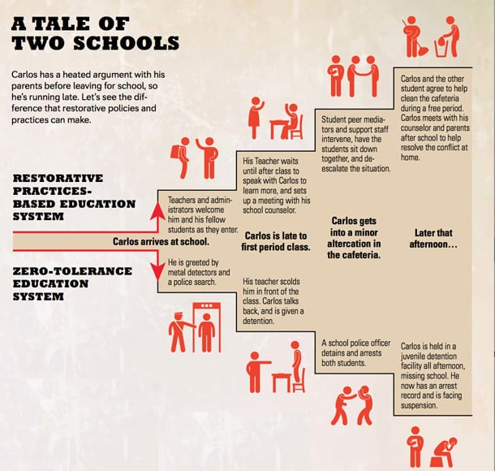
AN EXAMPLE
89%

Slide 3
CONTEXT · 2023–24
Students with disabilities are 15% of enrollment
and 89% of restraint and isolation incidents.
Share of middle school enrollment
32,147 of 218,387 students
15%
Share of restraint and isolation incidents
1,176 of 1,325 incidents
89%
Students without disabilities account for 81 incidents. Another 68 sit in schools where the disability count was suppressed.
OSPI, schools with “middle” in the name. “Students with disabilities” is the IDEA category, broader than an emotional or behavioral label. Counts under 3 incidents are suppressed in 2023–24.

Slide 4
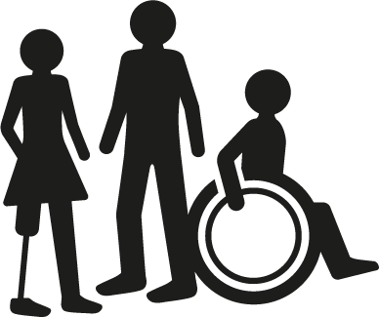
THE PATTERN
Why are disabled students more likely to be suspended?
01
02
03
Deficit mislabeling
Rights going unmet
Pushout
Stereotypes and lack of training lead educators to read a sensory meltdown as defiance or threat. The behavior is not met with de-escalation, evidence-based support, or a look at the cause.
IDEA and Section 504 require accommodations, positive behavioral supports, and the safeguards in an IEP or 504 plan. Schools may skip those duties and discipline students in ways that violate their rights.
Suspension, expulsion, and removal cut disabled students off from learning. Minor incidents are handed to school resource officers, and referrals move students toward the school-to-prison pipeline.

Slide 5

DEVELOPMENT
The middle school brain
01
02
03
Plasticity
Executive function
Co-regulation
Early adolescence is a period of rapid neural remodeling. The nervous system is highly sensitive to stress, perceived threat, and trauma.
Working memory and cognitive flexibility fluctuate. When academic or sensory demand overloads them, dysregulation is a stress response, not willful defiance.
Because the brain is this responsive, a calm adult in the room can lower fight-or-flight in the moment and build self-regulation over time.

Slide 6

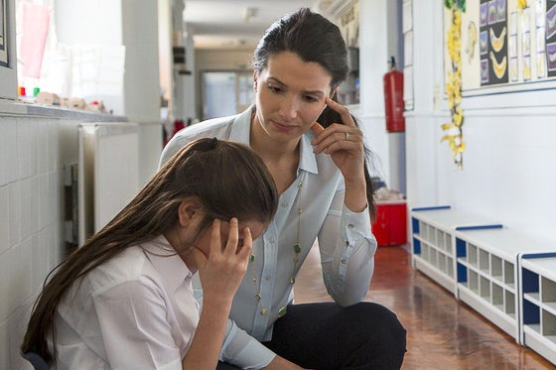
THE SHIFT
From “what is wrong with this student?”
to “what does this student need?”
TRADITIONAL
RESTORATIVE
Dysregulation is read as pathology: emotional disturbance, oppositional defiance.
The problem is placed in the child: non-compliant, disruptive, unmotivated.
The response is behavior modification, surveillance, and removal.
Ross Greene: kids do well if they can. Behavior signals lagging skills and an unmet need.
DisCrit: racialized and ableist systems pathologize students. Change the barrier, not the child.
The response is a changed environment, executive-function support, and repair.

Slide 7
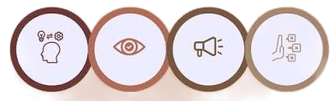
SAMHSA’S TRAUMA-INFORMED APPROACH
Safety is a condition for learning.
Chronic stress interrupts focus and self-regulation. Seclusion and restraint re-traumatize. With relational safety and the right support, students can recover.
Realize
Recognize
Respond
Resist
re-traumatization
Dysregulation is a survival response, not intentional defiance.
Learn how trauma shows up by age, gender, and setting.
Put the principle into policy, training, and the design of the room.
End seclusion and restraint that replay past harm.

Slide 8

IN THE ROOM
Four practices that keep students in the classroom.
Predictable routines
Cool-down corners
Visual anchors lower the working-memory load and the anxiety of not knowing what comes next.
A voluntary sensory reset inside the room, so regulation does not require removal.
The 2×10
Asset-based notes
Two minutes of personal connection, for ten days in a row, before a crisis.
In the IEP, name the unmet need. Do not write the behavior as a character flaw.

Slide 9

BEYOND ONE CLASSROOM
What the system has to change.
01
End isolation
Support the Washington effort to eliminate isolation booths.
02
Fund the training
Move discipline dollars into schoolwide restorative practice.
03
Call families first
Learn home regulation strategies before a crisis, not after a write-up.
04
Publish the disparity
Hold districts accountable for discipline rates among disabled students.

Slide 10
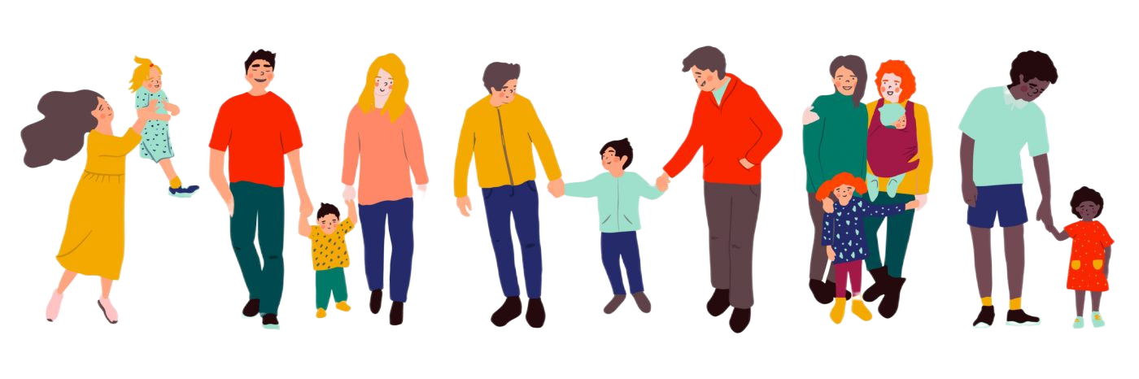
PARTNERSHIP
Families are experts, not recipients of notices.
01
02
03
Before the crisis
How we write home
Students at the table
Ask families what already helps their child regulate, and what sets them off. Treat that knowledge as part of the plan.
Replace deficit incident reports with collaborative problem-solving. Families should be partners in repair.
Middle schoolers help write their sensory-break plans, IEP accommodations, and community agreements.

Slide 11


OUR CHARGE
Humanize the student in front of you.
Dismantle the pipeline
Stop using a diagnosis to justify seclusion, restraint, and pushout.
Change the room
Replace surveillance with executive-function support, de-escalation, and repair.
Protect belonging
Guard the dignity and agency of every disabled and neurodivergent student.

Slide 12
SOURCES
References
Office of Superintendent of Public Instruction. (2025). 2023–24 restraint and isolation data [Data set]. ospi.k12.wa.us/student-success/health-…r/restraint-and-isolation
The Education Trust. (2020, August 12). How school discipline disproportionately targets students with disabilities.
National Center for Learning Disabilities. (2020). Significant disproportionality in special education: Current trends and actions for impact. ncld.org/wp-content/uploads/2025/09…ity-in-Special-Education.pdf
Baglieri, S. (2023). Disability studies and the inclusive classroom: Critical practices for embracing diversity in education (3rd ed.). Routledge.
Disability Rights Washington & American Civil Liberties Union of Washington. (2023). Coming into the light: An examination of restraint and isolation practices in Washington schools. disabilityrightswa.org/wp-content/uploads/…ation-Report-dist.pdf
Morris, M. W. (2016). Pushout: The criminalization of Black girls in schools. The New Press.
National Child Traumatic Stress Network. (2008). Child trauma toolkit for educators.
Wood, C. (2015). Yardsticks: Children in the classroom, ages 4–14 (4th ed.). Center for Responsive Schools.
Ginwright, S. (2016). Hope and healing in urban education: How urban activists and teachers are reclaiming matters of the heart. Routledge.
Greene, R. W. (2008). Kids do well if they can. Phi Delta Kappan, 90(3), 160–167.
Greene, R. W. (2014). Lost at school: Why our kids with behavioral challenges are falling through the cracks and how we can help them. Scribner.
Annamma, S. A., Ferri, B. A., & Connor, D. J. (Eds.). (2022). DisCrit expanded: Reverberations, ruptures, and inquiries. Teachers College Press.
Davis, D. R., & Annamma, S. A. (2023). Disabling discipline: DisCrit, restorative justice, and anti-ableist schooling. Remedial and Special Education, 44(1), 18–29.
Substance Abuse and Mental Health Services Administration. (2014). SAMHSA’s concept of trauma and guidance for a trauma-informed approach (HHS Publication No. SMA 14-4884). U.S. Department of Health and Human Services.
Mendler, A. N. (2001). Connecting with students. Association for Supervision and Curriculum Development.
Mingus, M. (2019). Transformative justice: A brief description. Leaving Evidence.

